Slide 1
Classification and Phylogenetics Notes

Slide 2
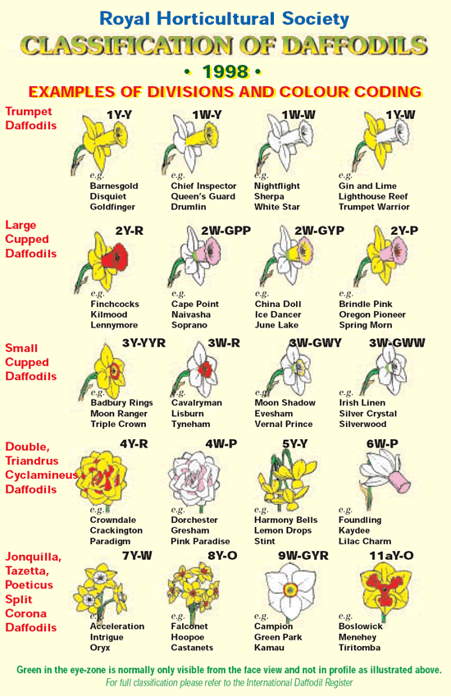
Why Classify?
To name organisms and group them in a logical manner (also called taxonomy)

Slide 3
Binomial Nomenclature
2 Name naming system
Examples: Homo sapiens (1st word is capitalized and is the genus, 2nd word is not capitalized and is the species.); Ursus arctos (grizzly bear); Ursus maritumus (polar bear)

Slide 4
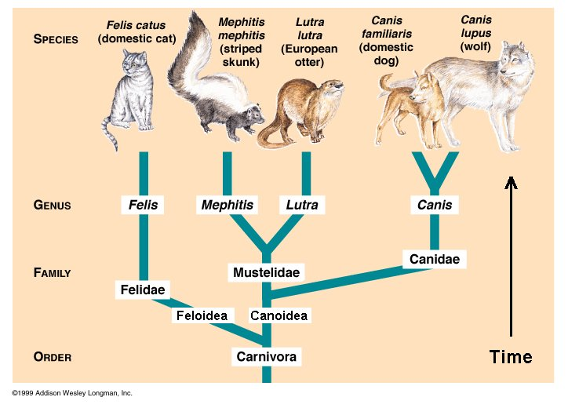
Why?
Common names are often confused—Buzzard in England refers to a hawk, here it refers to a vulture
Latin is used because it’s a dead language and cannot be changed

Slide 5
Carl Linneaus
Came up with the naming system
Classify according to biological traits, evolution and DNA
Kingdom
Phylum
Class
Order
Family
Genus
Species

Slide 6
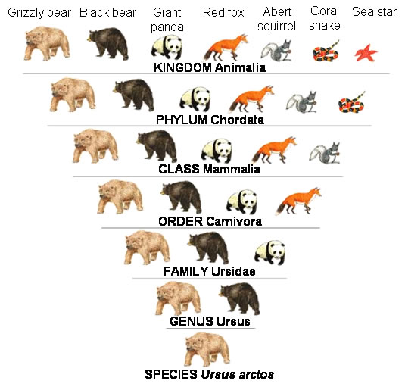

Slide 7
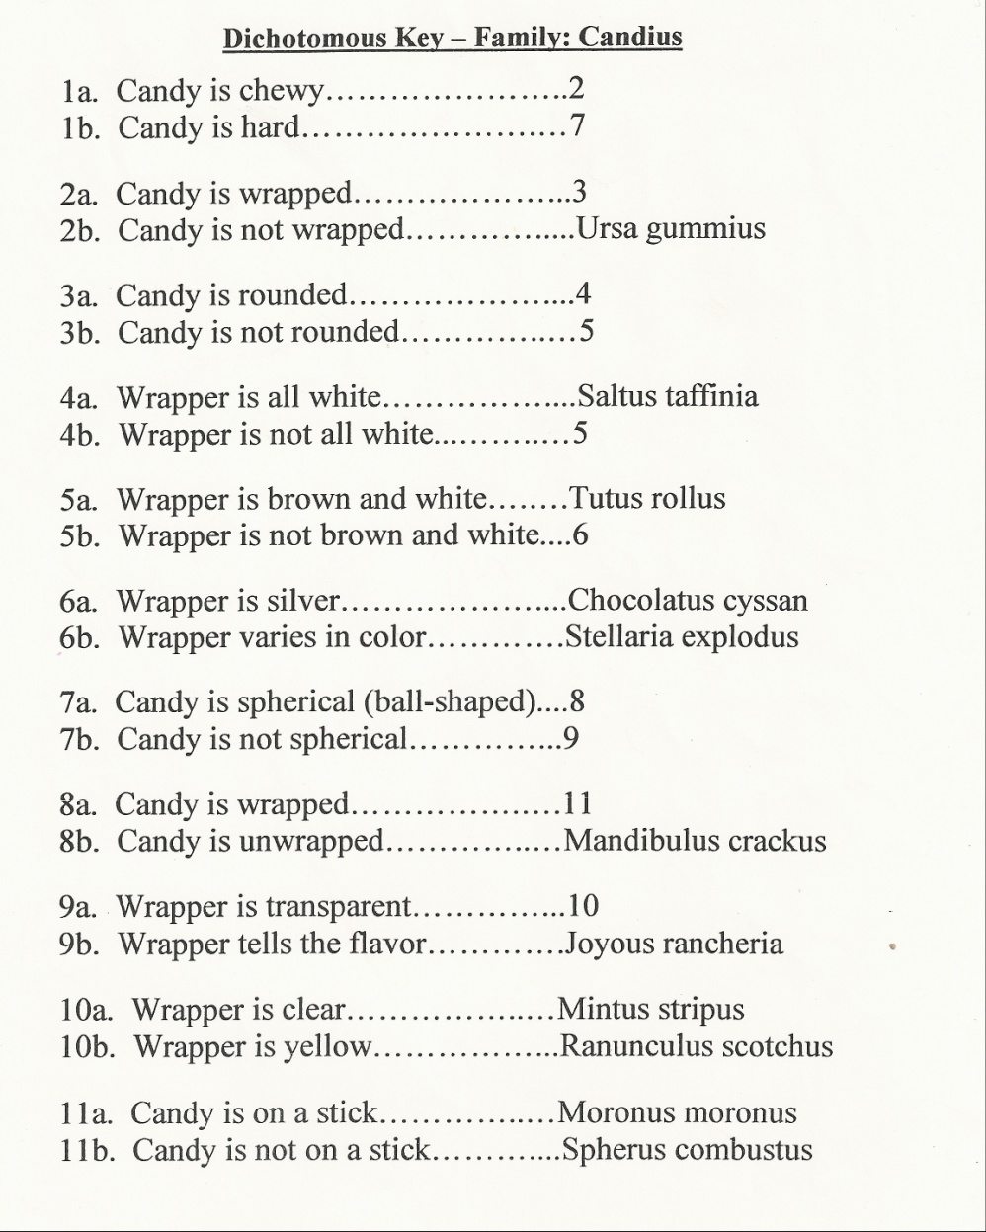
Using a dichotomous key
Group organisms by continuously separating them into 2 categories

Slide 8
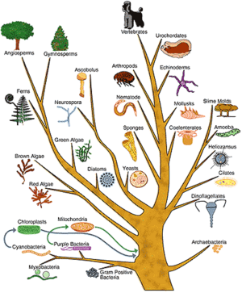
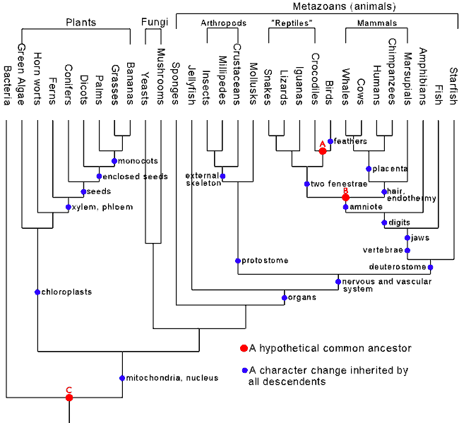
Phylogenetic Tree (Cladogram)
a tree showing the evolutionary relationships among various biological species

