Slide 1
Meiosis

Slide 2
How are unique gametes formed?
Independent Assortment:
This is the formation of random combinations of chromosomes in Meiosis and of genes on different pairs of homologous chromosomes according to Mendel’s Laws
Crossing over
Exchange in genes between homologous chromosomes, resulting in the mixture of parental characteristics in offspring.

Slide 3
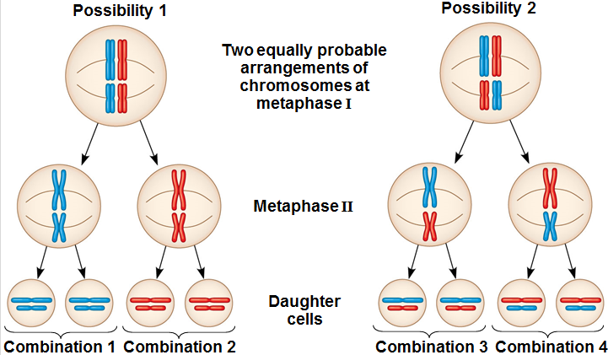
Independent Assortment

Slide 4
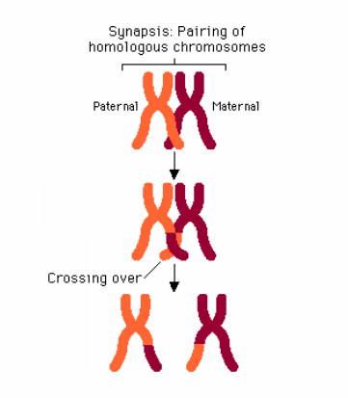
Crossing Over

Slide 5
What’s the difference?
Crossing over is the exchange of DNA between homologous chromoes
Takes place in Prophase 1 of Meiosis
Independent Assprtment is the pairing of homologous chromosomes in the middle of the cell
Takes place during Metaphase 1 of Meiosis

Slide 6
