Slide 1
What does good note taking look like?
-Title the page
-Make a section for questions
-Don’t write down every word!
-Use highlighters to make important things stand out
-If you add to the notes later, do it in a different color
-Make a summary section at the bottom

Slide 8
Starburst activity
We are going to walk outside to the tennis courts.
I will assign you a trophic level, stand where directed.
Producers take no steps (just like trees)
Primary Consumers may take a step with one foot, leaving the other
Secondary Consumers may take two steps
Tertiary Consumers may take three steps
You will be throwing starburst over your shoulder without looking where it’s going. Gently, we don’t want to poke an eye out.
Pay attention to how much candy makes it to the back rows. We will return to class and report our data.

Slide 9
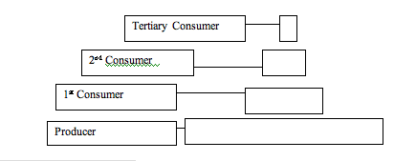
What happened to the number of Starbursts (the energy) as they moved through the food chain?
Answer this question in your notebook.
How much energy is lost between each level?
Draw this table and
fill in the blanks with
Percentages

Slide 11
Why is the box at the base of the food pyramid larger than the top level?
A huge portion of the energy in the world is lost. For example sunlight: only about 20% of the sunlight even makes it to plants and algae. Most of the energy from the sun is lost in space, reflected by clouds and water, or absorbed by the earth itself. How much energy is lost on average for the energy pyramids above?
As organisms die and decompose in the soil, their energy is not gone. For example, a dead tree can be cut and burned to produce heat, a different type of energy. Write three other example of dead organism providing energy long after it is gone.

