Slide 1
Evidences of evolution

Slide 2
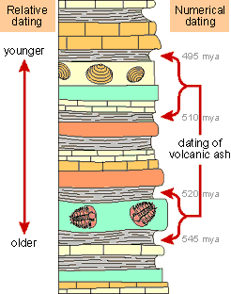
Fossils
Found species that don’t exist anymore
Relative Dating: Determine how old the earth is by layers/fossils in the rock
Absolute Dating: Use half-lives (time required for half of sample to decay) to determine the age of rocks

Slide 3
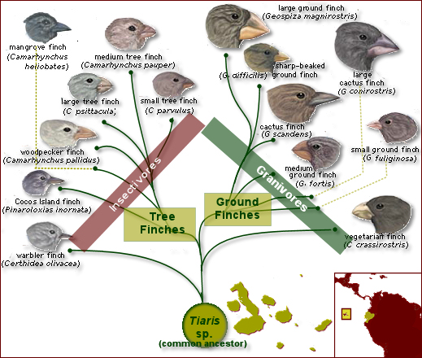
Geographic distribution
Find common ancestors of organisms that have changed because of their environment
Find organisms that are not related but look similar due to their environments

Slide 4
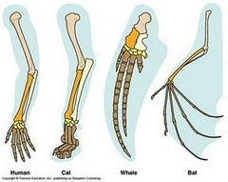
Homologous body structures
Structures in different organisms that came from a common ancestor (fins of a whale and a human arm)
Opposite of homologous is analogous structures (perform similar functions but are not related)

Slide 5
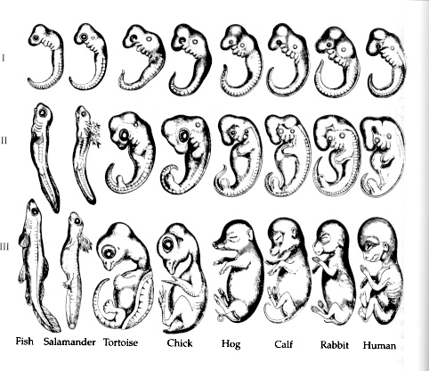
Embryonic development
Embryos look alike when in first stages of development

Slide 6
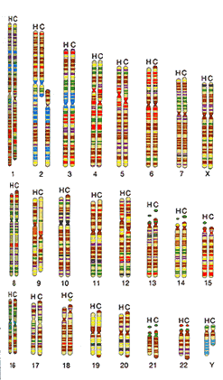
Dna similarities

