Slide 1
Evolution Notes

Slide 2
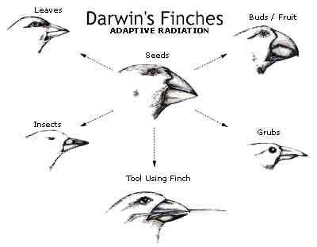
Natural Selection – survival of the fittest
Variation happens naturally and is inherited
Nature selects which traits are best suited for the environment

Slide 3
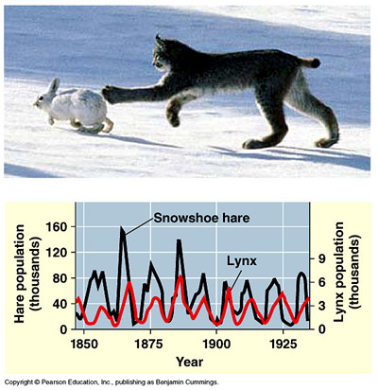
3 Requirements for Natural Selection to Occur
Population needs to be limited in order to create competition

Slide 4
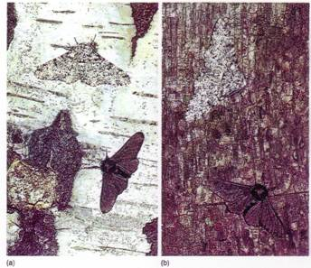
Genetic Variation Must Exist

Slide 5
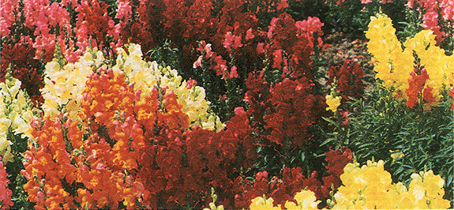
Variations must affect reproductive success

Slide 6
Adaptations
In order to create genetic variation, adaptations must occur
Adaptations are inherited characteristics that increase an organism’s chance of survival
Genetic variation or adaptations can occur because of 1. mutations or 2. genetic shuffling through recombination or meiosis

Slide 7
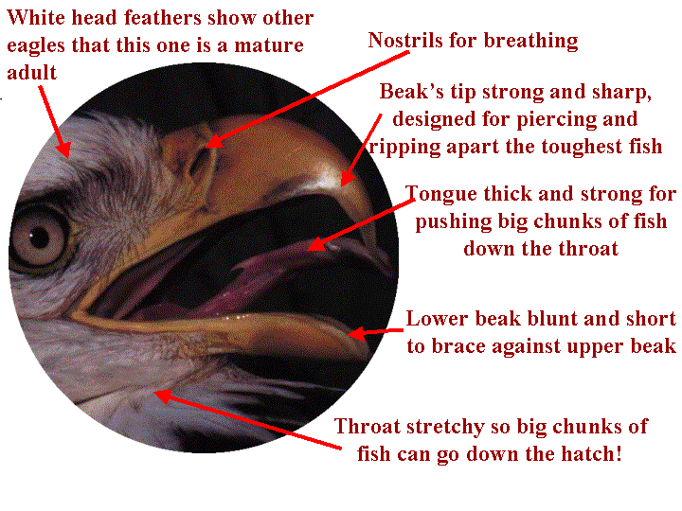

Slide 8
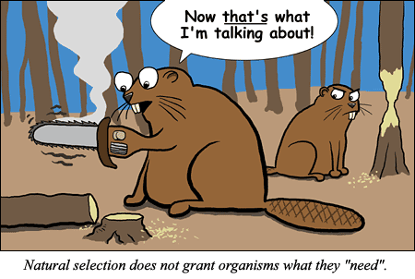

Slide 9
