Slide 1
Evolution

Slide 2
Common concerns and misconceptions
How does it work?
Did we evolve from monkeys?
How did we get here?
Does it apply to every living thing?
What causes evolution?
Will evolution ever stop?
How long does evolution take?
Why do things change?
What is the difference between evolution and Natural Selection?
How do we know evolution has occurred?
Does it conflict with my religion?

Slide 3
What’s the conflict?
https://www.youtube.com/watch?v=RRdAe3UAIVs
http://www.cuttingedge.org/n1034.html
https://nelsonlab.byu.edu/Portals/27/docs/BYU_Evolution_Packet_only.pdf

Slide 4
Cake or Pie?
An objective perspective is one that is not influenced by emotions, opinions, or personal feelings - it is a perspective based in fact, in things quantifiable and measurable.
A subjective perspective is one open to greater interpretation based on personal feeling, emotion, aesthetics, ect.

Slide 5
What is a theory?
An explanation of multiple phenomena based on proven hypotheses
Can be repeatedly tested
Have withstood lots of scrutiny
Examples of scientific theories:
Cell Theory
Heliocentric Theory
Theory of Relativity

Slide 6
How is a theory different from a law?
Laws explain how things will act under SPECIFIC CONDITIONS
Theories are broader – explaining how nature works, etc.
A theory will always remain a theory and a law will always remain a law

Slide 7
So, what is evolution?
The theory of evolution states that all the lifeforms on earth share a common ancestor as a result of variation and selection over a very long time (currently thought to be around 4 billion years).
Evolution as a process is the changing and development of new species over time.

Slide 8
Do we have evidence of evolution?
Yes, a lot of it!
We have case studies of species evolving over time, as well as evidence that species have evolved in the past before humans were here to study it.
https://www.youtube.com/watch?v=LyRA807djLc

Slide 9
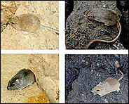
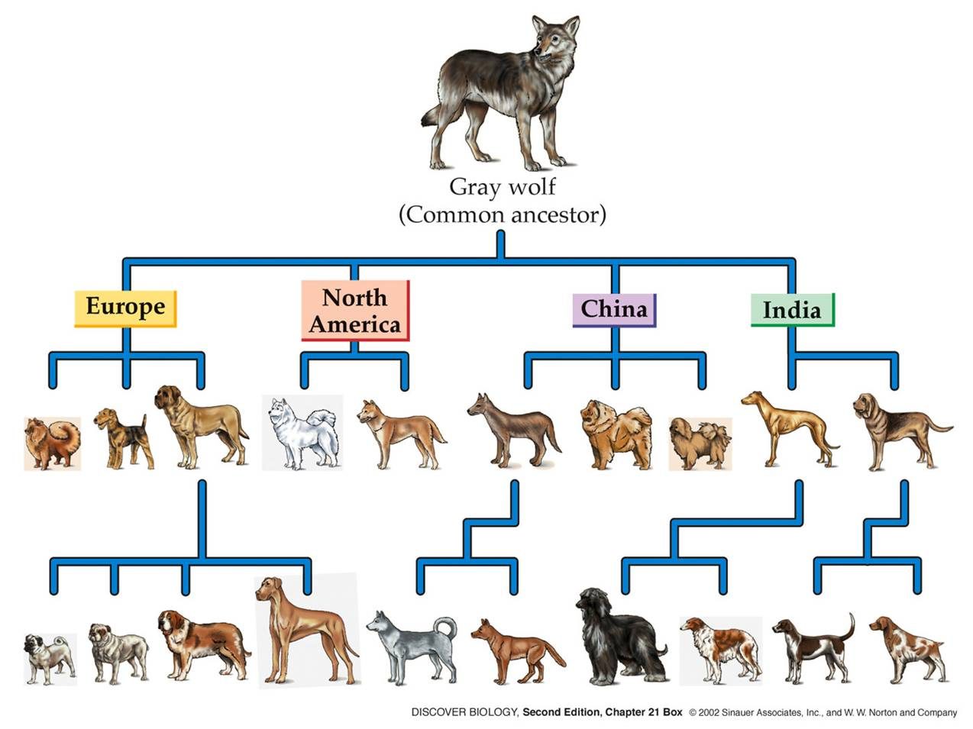
What is the difference?
Natural Selection vs. Artificial Selection

Slide 10
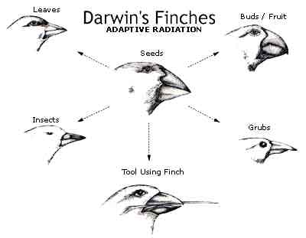
Natural Selection – survival of the fittest
Variation happens naturally and is inherited
Nature selects which traits are best suited for the environment

Slide 11
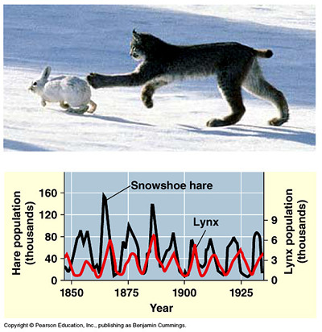
3 Requirements for Natural Selection to Occur
Population needs to be limited in order to create competition

Slide 12
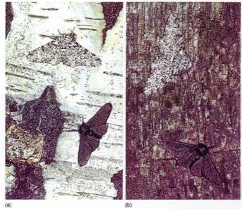
Genetic Variation Must Exist

Slide 13
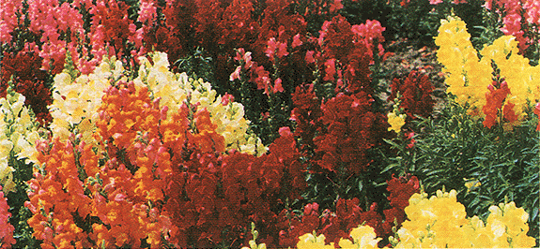
Variations must affect reproductive success

Slide 14
Adaptations
In order to create genetic variation, adaptations must occur
Adaptations are inherited characteristics that increase an organism’s chance of survival
Genetic variation or adaptations can occur because of 1. mutations or 2. genetic shuffling through recombination or meiosis

Slide 15
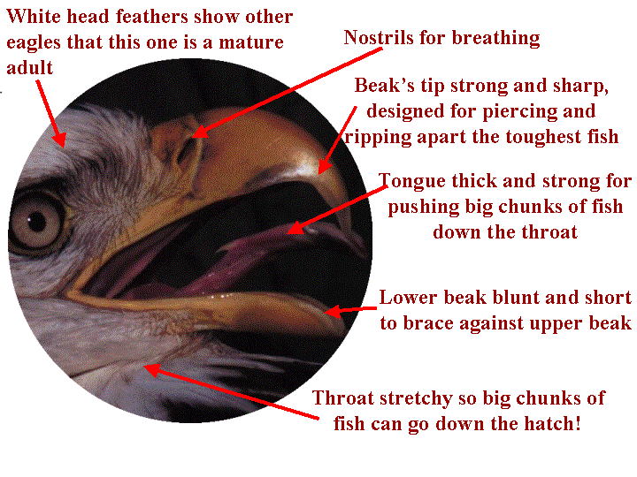

Slide 16
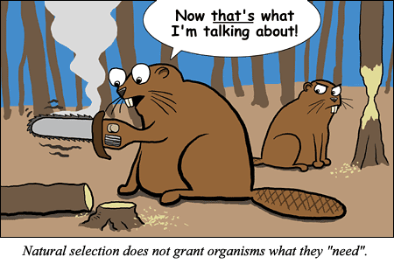

Slide 17
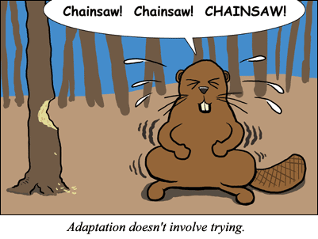

Slide 19
Evidences of evolution
http://www.vox.com/2016/3/17/11250962/proof-evolution-vestigial

Slide 20
Fossil Record
Can date fossils to find out how old they are
Find intermediate species – “missing links”
Fossils of organisms and species that no longer exist today

Slide 21
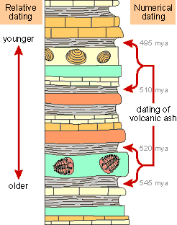
Fossils
Found species that don’t exist anymore
Relative Dating: Determine how old the earth is by layers/fossils in the rock
Absolute Dating: Use half-lives (time required for half of sample to decay) to determine the age of rocks

Slide 22
Horse Evolution through fossil record

Slide 23
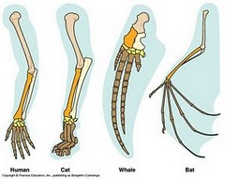
Homologous body structures
Structures in different organisms that came from a common ancestor (fins of a whale and a human arm)
Opposite of homologous is analogous structures (perform similar functions but are not related)

Slide 24
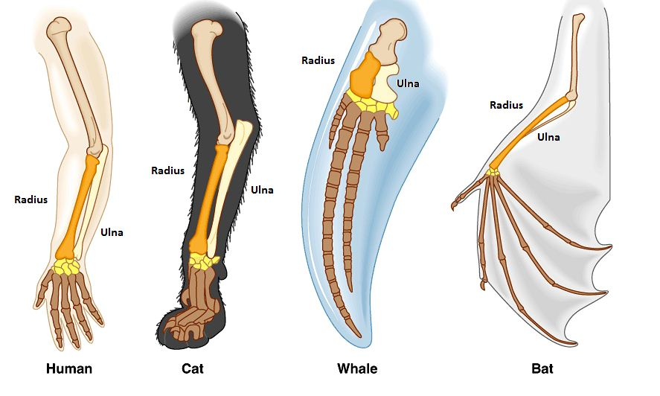

Slide 25
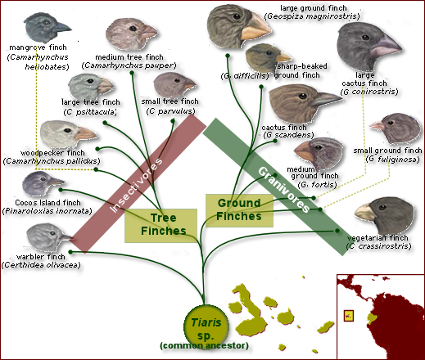
Geographic distribution
Find common ancestors of organisms that have changed because of their environment
Find organisms that are not related but look similar due to their environments

Slide 27
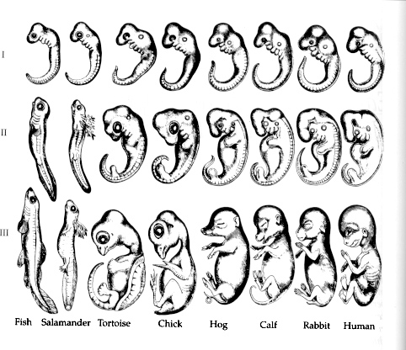
Embryonic development
Embryos look alike when in first stages of development

Slide 28
DNA Evidence
We share certain percentages of our DNA with other species
Chromosomal similarities/mutations

Slide 29
Atavisms
“Evolutionary Throwback”
A revert to an ancestral phenotype

Slide 33
Vestigial Structures
Evolutionary Leftovers
Traits that no longer are in use

Slide 37
Mechanisms of evolution

Slide 38
What is a population?
A group of animals of the same species that mate with each other and *usually* live in the same place

Slide 39
Mutation
Mutations are random
Mutations are the source of variation
Mutations are the driving force behind evolution!

Slide 40
Migration
As organisms move between populations, new alleles and traits can be introduced into populations of new environments

Slide 41
Natural Selection
Selective Pressures
Environment
Predator
Food Source
Shelter
Disease
Natural Disaster
Organisms that can survive better, live longer and therefore reproduce more

Slide 42
Sexual Selection
Most appealing to opposite sex gets to reproduce most, and their genes are more prevalent in the next generation.

Slide 43
Reproductive Isolation
Geographic
Physical barriers – rivers, mountains, etc. prevent organisms from breeding with each other
Temporal
Mate at different times
Behavioral:
Mating behaviors differ so they don’t interbreed (even though they could)

Slide 44
Example of Geographic Isolation

Slide 46
Could technically mate but use different songs to attract a female.

