Slide 1
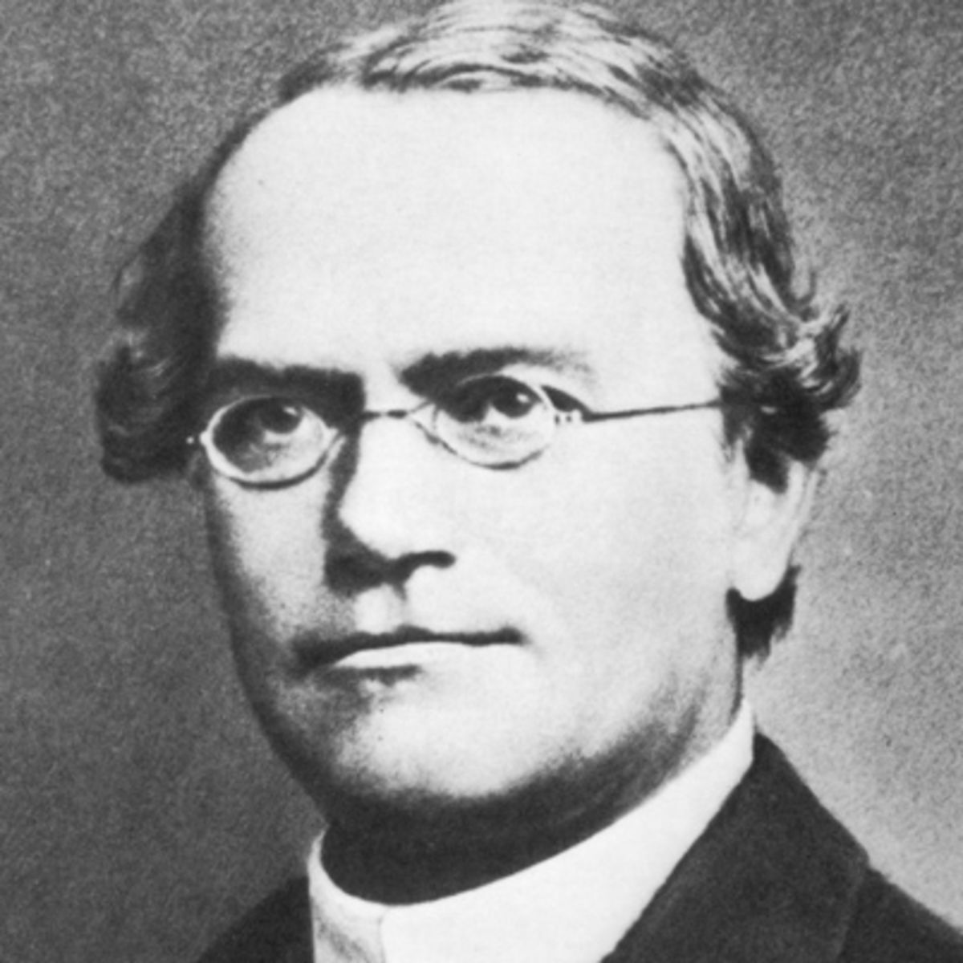
Laws of Inheritance
Mendel

Slide 2
Mendel’s First Law
The law of Segregation
Two alleles in a gene separate to form a gamete

Slide 3
Mendel’s Second Law
The Law of Independent Assortment states that when alleles separate at random independently.

Slide 4
Mendel’s Third Law
The Law of Dominance states that the dominant allele will mask the recessive allele in all traits.

