Slide 1
Theory Notes

Slide 2
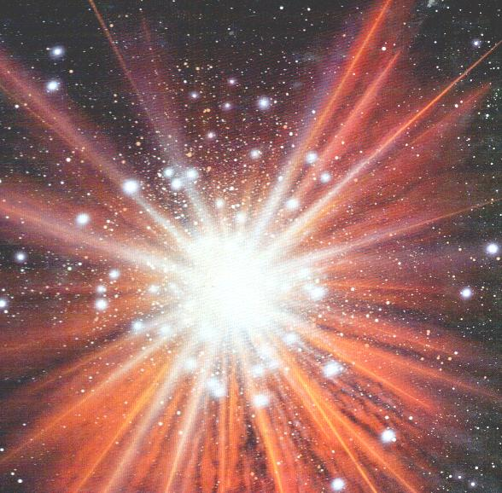
Theory
An explanation for many observations based on proven hypotheses
Examples: Big Bang, Evolution, Plate Tectonics, etc.

Slide 3
Hypothesis
A single educated guess based on observation.
Example: If…then

Slide 4
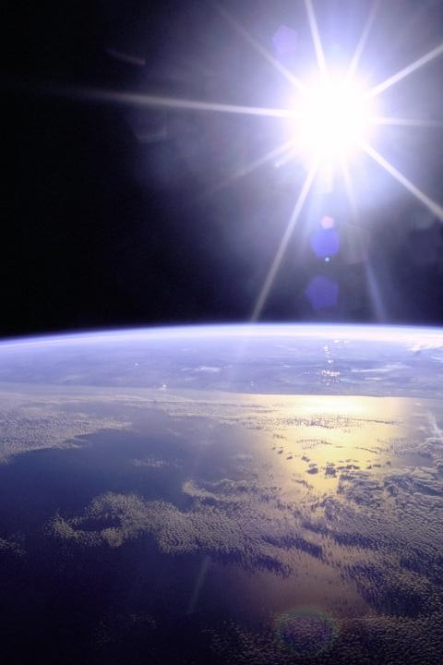
Fact
Evidence that does not change and most likely won’t
Example: The sun rises in the east

Slide 5
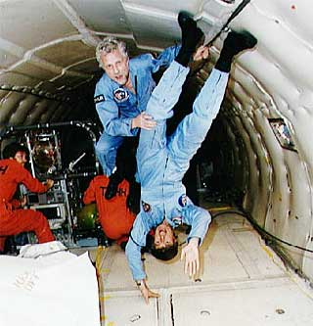
Law
Describes something that always happens when certain conditions are met.
Example: Law of gravity

Slide 6
Superstition
A believe caused by what is unknown or mysterious
Example: salt over the shoulder for good luck

